Slide 1

CSS Scan 2.0
‘Inspect’ made intuitive

Slide 2



Introduction
CSS Scan is a chrome extension and a Firefox add-on.
It allows the user to view CSS styles in the browser. Our tool is much faster and more intuitive than using Chrome Devtools, and allows quick copying or freezing the chosen style in place.

Slide 3
Until today...
Web developers and designers
Curious about an interesting color, font, or layout? while browsing a favorite site, looking for inspiration for a certain project, for debugging their own site.
Looking for a specific element and CSS through Devtools is old-fashioned and slow.

Slide 4



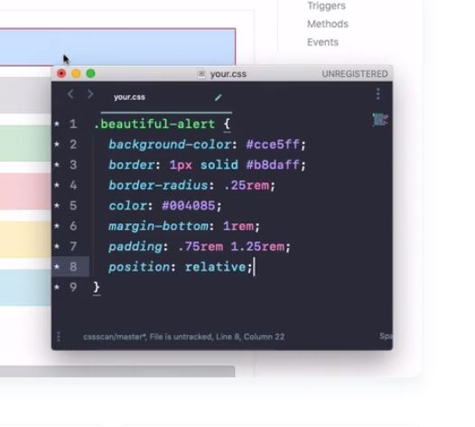
CSS Scan
Hover and see
Copy
Pick an element
1
3
Watch CSS:
clean, simplified, and without ‘trash CSS’
2
Copy CSS to your clipboard with one click, or freeze it in place using ‘space’
Choose any element you see on screen, just hover it

Slide 5



Alternative Products
Toybox
Designed for teams: Adds a shared layer on top of the site
(10$ monthly)
Amino
Designed for better experience while you browse
(free)
CSS Peeper
Geared towards designers, still great
(free)

Slide 6


